Slide 1
Lecture 3.Terminologies and
Mendelian concepts

Slide 2
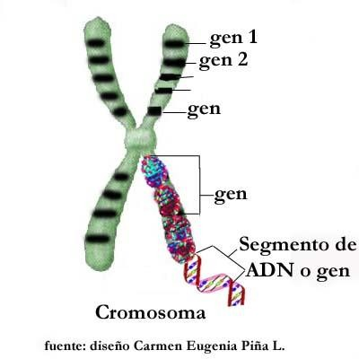
Terminologies
GENE - Unit of inheritance located at a fixed position (i.e. Locus) on a chromosome. The term gene was coined by Johannsen

Slide 3
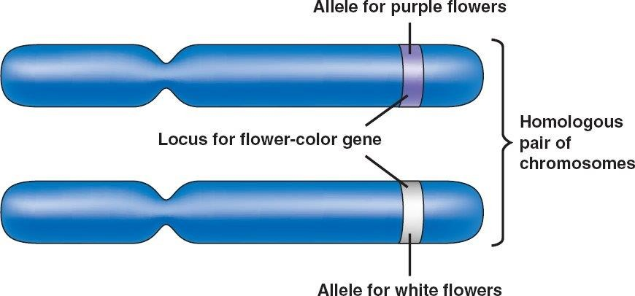
Terminologies
ALLELE: (Allelon - one another, Morphus - Form)
Alternative form of a gene. Mendel recognized the presence of constant differentiating characters.
These contrasting characters are attributed to the presence of allelomorphus, situated at the same locus of homologus chromosomes.

Slide 4
DEFINITION
GENE SYMBOLS
Dominant gene is represented by capital letter and its recessive allele by the corresponding small letter.
Homozygote (Bateson) - An organism derived from the
union of gametes of
e.g. RR, rr
Heterozygote (Bateson)
similar genetic constitution
An organism derived from the union
dissimilar genetic constitution e.g Rr.
of gametes of

Slide 5
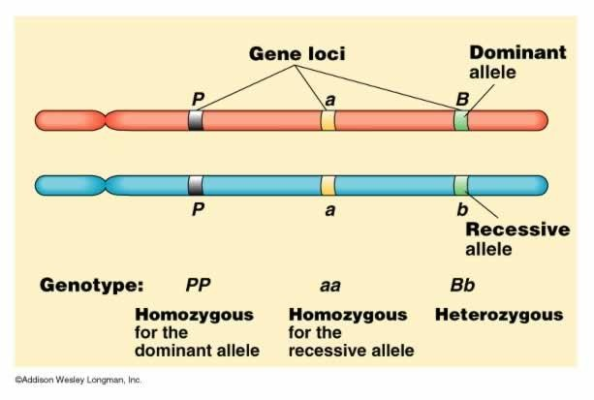
Terminologies
Locus :
chromosome
gene occupying a fixed position in the

Slide 6
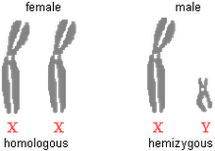
Terminologies
Hemizygous: Having only a single copy of a gene instead of the customary two copies.
All of the gene on the single X chromosome in the male are in the hemizygous state.

Slide 7
Terminologies
Phenotype (Pheno- appear) - (Johannsen)
It is the external appearance of an organism.
It is the result of the interaction between genotype and environment.
Genotype (Johannsen)
It is genetic make up of organism
The entire genetic constitution of an organism e.g. TT – Genotype

Slide 8
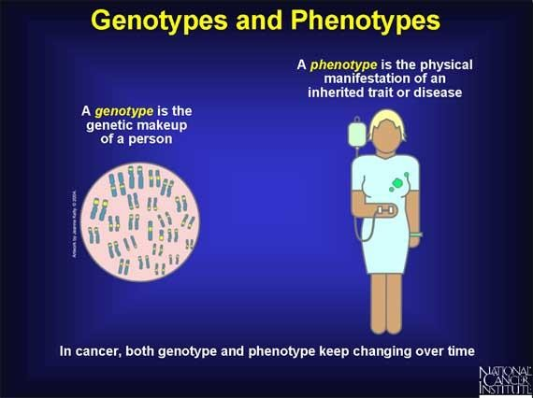

Slide 9
Terminologies
HYBRID:
The progeny obtained by crossing two pure breeding parents of different genotypes
MONOHYBRID
A cross between parents differing in a single gene.
An individual heterozygous for one pair of alleles.
Mendel formulated the law of segregation from the results of a monohybrid cross

Slide 10
Terminologies
DIHYBRID CROSS
This is a cross which involves parents differing for two pairs of contrasting characters.
Mendel formulated the law of independent assortment from the results of a dihybrid cross

Slide 11
Mendel's monohybrid cross
Mendel studied the inheritance of each of the seven pairs of contrasting characters selected by him in peas in separate crosses.
For example, he crossed a variety of peas having round seeds with a variety having wrinkled seeds.
The hybrid seeds from this cross were all round.
He planted these hybrid round seeds and obtained an F2 generation consisting of round and wrinkled seeds in the proportion of 3:1.

Slide 12
Monohybrid cross
Round X
RR
Wrinkled
rr
F1
Round Rr
1RR 2Rr 1rr
3 Round : 1 Wrinkled
Phenotypic ratio 3:1
Genotypic ratio: 1: 2 :1
F2

Slide 13
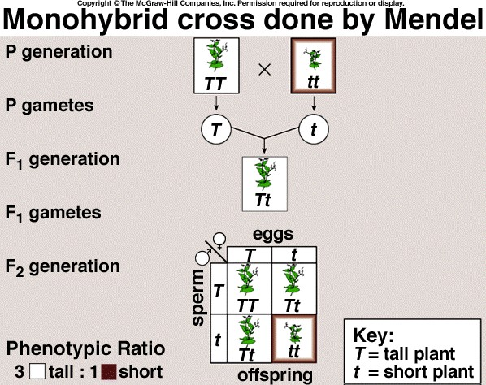

Slide 14
Mendel's dihybrid cross
Mendel crossed a variety with round and yellow seeds with a variety with wrinkled and green seeds.
The F1 hybrid seeds were all round and yellow.
The F2 , ratio is 9:3:3:1
F₂ ratio of hybrid round | F₂ ratio of hybrid yellow | F₂ ratio of hybrid round and yellow
3 R | 3 Y 1 y | 9 RY (round yellow) 3 Ry (round green)
1 r | 3 Y 1 y | 3 rY (wrinkled yellow) 1 ry (wrinkled green)

Slide 15
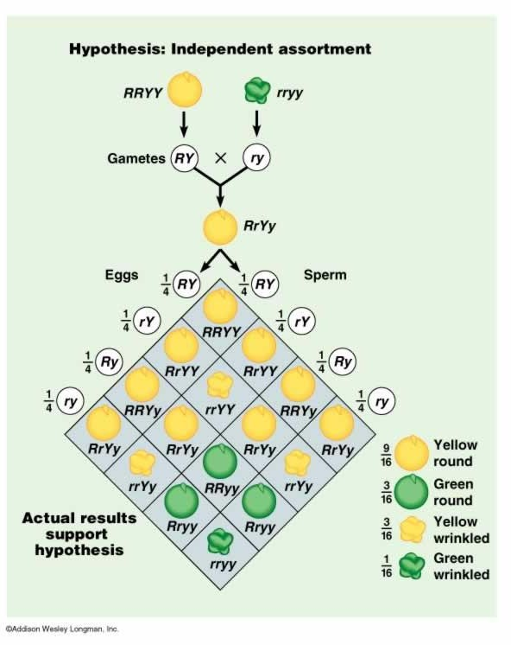

Slide 16
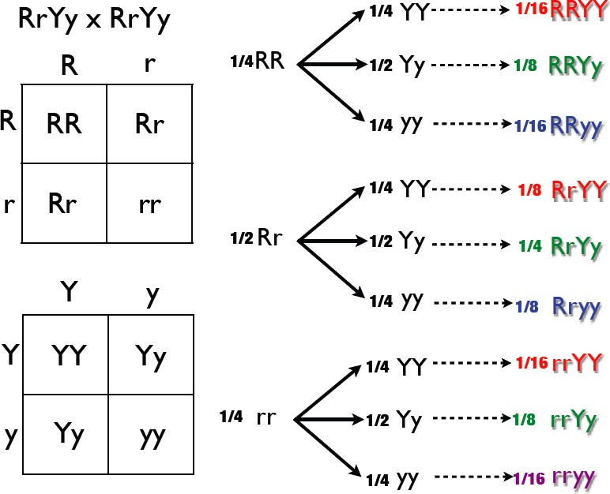
Dihybrid cross tree method

Slide 17
DEFINITION
Tri hybrid
The progeny from a cross between parents differing in three genes
Polyhybrid
This is a cross which involves parents differing for many pairs of contrasting characters.

Slide 18
No. of gene | Phenotypic ratio | No. of phenoty pes | No. of genotype s | Genotypic ratio
1 | (3:1) | 2 | 3 | (1:2:1)
2 | (9:3:3:1) | 4 | 9 | (1:2:1:2:4:2:1:2:1 )
3 | 27:9:9:9:3:3:3:1 | 8 | 27
 | Different kinds of gametes produced | ₂n | ₃n
Where’ n’ is
no. of genes for a character

Slide 19
Terminologies
Backcross
Backcross is a cross between hybrid and any one of the parents
Testcross
Testcross is a cross between hybrid and a recessive homozygote.
Monohybrid test cross ratio 1:1
Dihybrid test cross ratio 1:1:1:1
Reciprocal crosses
It is a second cross involving the same characters as the first but with the sexes of the parents interchanged.

Slide 20
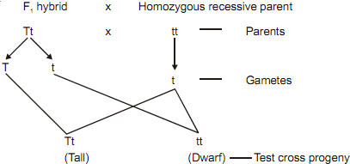
Monohybrid test cross ratio (1:1)

Slide 21
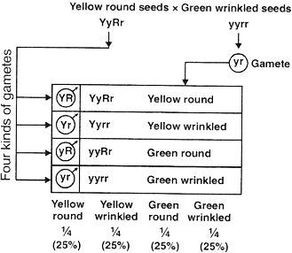
Dihybrid test cross ratio (1:1:1:1)

Slide 22
The Laws of Mendel
Law of dominance:
On crossing homozygous organisms for a single pair of contrasting characters, only one character make its appearance in F1 generation and is named as dominant character.
Law of segregation: (Mendel's First Law)
If two alleles are brought into a hybrid, They do not contaminate or blend with each other but segregate and pass into different gametes.
Law of independent Assortment: (Mendel's Second Law)
When two or more pairs of alleles are brought into a hybrid, The segregation of any one pair of allele is independent to that of segregation of any other pair of allele.

Slide 23
Mendel's laws - Mendel created three laws
Rule of Unit Factors - each organism has two(2) factors (called alleles) for each physical
trait. Alternative alleles explain the variations in inherited characteristics. Not all genes are as simple as tall/short or purple/white.
allele - different forms of the same gene

Slide 24
Law of Dominance - some traits mask the appearance of other traits.
dominant - will always be seen, represented by a capital letter (ex. "R")
recessive - hidden unless paired with another recessive, represented by a lowercase letter (ex. "r")
Law of Segregation - two(2) alleles separate during meiosis to form gametes
Law of Independent Assortment - each trait separates independently of each other

Slide 25
phenotype - the physical characteristics of an organism (ex. blue eye), it is determined by the genotype
genotype - the genetic makeup of an organism
homozygous - a pair of genes that are the same (ex. "RR" or "rr")
heterozygous - a pair of genes that are different (ex. "Rr")

Slide 26
Punnett Squares - These are the tools that we use to determine the genetic possibilities of various combinations of parents
Bb
BB | Bb
Bb | bb
Bb
BB Bb Bb 1/4 2/4
bb 1/4
3
:
1

Slide 27
Generations
Test Cross - These are used to determine the missing gene in a dominant phenotype. It crosses a dominant phenotype (R_) with a recessive phenotype (rr). If the cross creates:
RR x rr -> Rr 100% tall offspring, or
Rr x rr -> Rr 50% tall offspring and rr 50% short offspring so it proves the existence of a recessive allele in the dominant parent.
P generation - represents parents
F₁ generation (first filial) - offspring of these (P) parents
F₂ generation (second filial) - offspring of these (F₁) parents

